Slide 1
Gomory-Hu Tree
Soham Chakraborty
22CS02002
Supervisor: Dr. Joy Chandra Mukherjee

Slide 2
Table of Contents
Gomory-Hu Tree
Dynamic Gomory-Hu Tree
Applications
Image Segmentation
References
C++ implementation – Github Repo

Slide 3
Gomory-Hu Tree
Gomory-Hu Tree is a min-cut tree which solves the problem of computation of Multi-Terminal Network Flows for an undirected graph with only (n-1) flow computations.
Time Complexity of Construction – (n-1) * O(max_flow)
Motivation - There exists only (n-1) numerically different flow values in a Graph.

Slide 4
Properties
For any 2 vertices, the min-Cut separating those vertices in the tree is also a valid min-Cut in the corresponding graph.
Flow between any 2 vertices in the graph is numerically equal to the minimum edge capacity on the path between those 2 vertices in the corresponding Cut-Tree.
Mathematical Representation - f(u,v) = min_{e } _{π(u,v)} c(e)

Slide 5
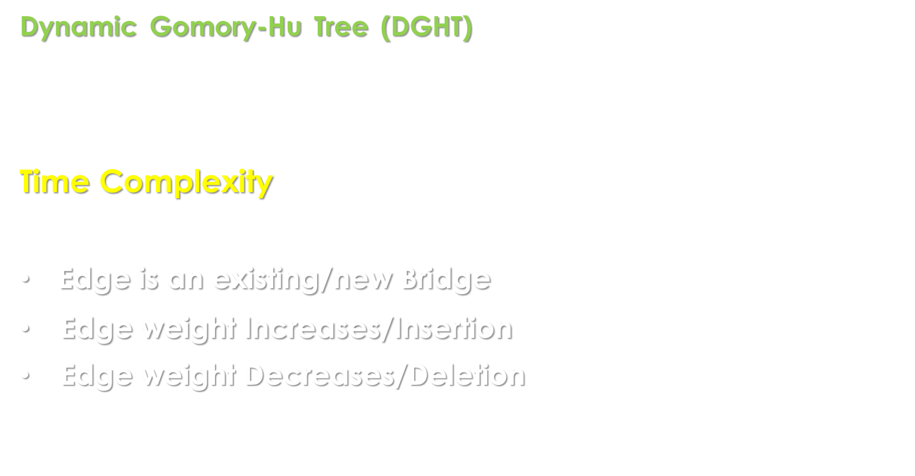
Dynamic Gomory-Hu Tree
Dynamic Gomory-Hu Tree (DGHT) allows us to efficiently update the initially constructed Gomory-Hu tree after each modification in each weight with minimal number of newer flow computations.
Time Complexity
For any 2 vertices u, v newer flow computations required:
Edge is an existing/new Bridge = 0
Edge weight Increases/Insertion = $|π\left(u,v\right)|$
Edge weight Decreases/Deletion $≤ 2+\sum_{x∈π(u,v)}{(deg\left(x\right)−2)}$
Worst case – Same as full Static Tree Reconstruction

Slide 6
Applications
Primarily all are cut-based Clustering:-
Computer Vision (Image Segmentation)
Network Reliability and Resilience analysis
Community Detection
Clustering of protein structures into strongly connected groups, to identify real PPI.

Slide 7
Image Segmentation
The goal of Image Segmentation is to partition an image into multiple separate images having some physical significance or meaning.
Hierarchical clustering algorithm is used.
Effectively equivalent to searching for closed contours containing isolated strong edges.

Slide 8
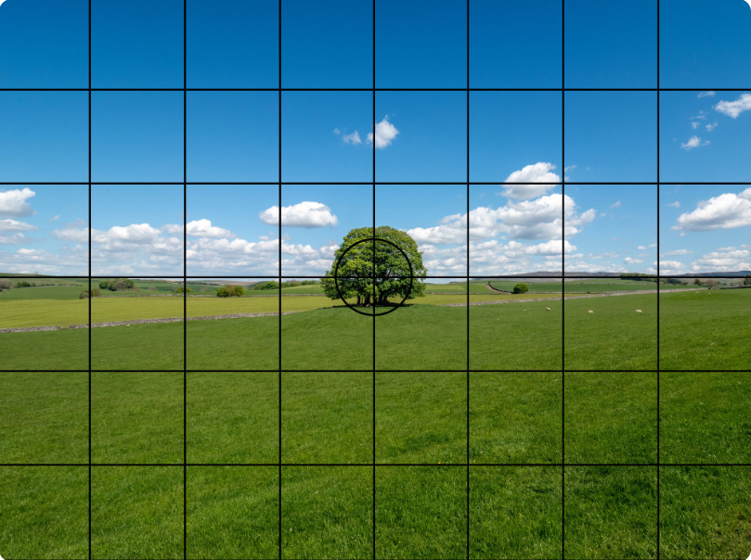

Step 1
Convert Image Matrix to Graph
Nodes = Pixels
Edges = Adjacent pixels
Edge weight c = $e^{−\frac{{(x−y)}^{2}}{σ}}$

Slide 9
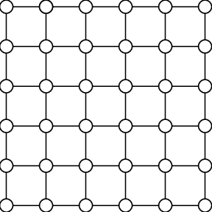
Step 2
Partition Graph into multiple of smaller subgraphs
Window size = 3 x 3 (here)

Slide 10
Step 3
Compute Gomory-Hu Tree for each subgraph

Slide 11

Step 4 (Condensation)
Permanently condense all vertices inside GHT having edge capacities $≥$ THRESHOLD.
Temporarily condense all maximal interior branches.
Permanent
Temporary

Slide 12
Step 5 – Construct condensed graph after Permanent and Temporary Condensation (in Step 4).
Step 6 – Construct new subgraphs by joining inter-subgraph edges.
If (no. of subgraphs == 1): go to Step 7
Else: go to Step 3
Step 7 – Create GHT of resultant condensed graph of reduced size.
Step 8 – Expand back temporarily condensed vertices.
Step 9 – Form clusters with some clustering condition.

Slide 13










Results
Synthetic Images (made in MS paint)

Slide 14





Real-life Image – 1
8000+ other clusters generated, containing 1 or 2 pixels.

Slide 15










Improvement-1: Minimum Limit on Partition size
Less than 20 unnecessary clusters generated.

Slide 16
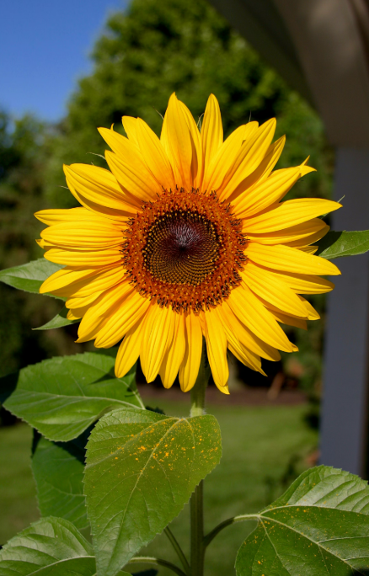








Real-life Image – 2
Sunflower gets shredded into a total of 53 clusters

Slide 17







Improvement-2: Increasing neighborhood of edges
Parts of sunflower remain intact and successfully separated.
Leaves are still somewhat shredded.

Slide 18





Real-life Image – 3
Successfully able to separate one flower but completely fails at the other two.

Slide 19
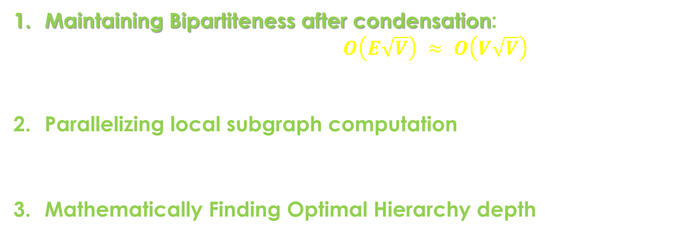
Execution Time Improvements
Maintaining Bipartiteness after condensation: Worst case flow computation improves to – $O\left(E\sqrt{V}\right) ≈ O\left(V\sqrt{V}\right)$
Parallelizing local subgraph computation
Mathematically Finding Optimal Hierarchy depth

Slide 20
Other Improvements
Optimally choosing Hyperparameters based on the input image rather than hardcoding.
Processing input separately for R,G,B channels and then combining them.
Capacity/Weight function based on the type of image.

Slide 21
Advantages
Unsupervised Image Segmentation.
No training time.
Very fast in case of high condensation (large portions of similar coloured regions).

Slide 22
Disadvantages
Poor results in case of Natural images (having low colour gradients).
High execution time for images having high resolution (over 1k).
A single object might be separated into multiple parts, since segmentation is primarily based on colour.

Slide 23
Future Works
Further improving Image Segmentation for better accuracy and runtime.
DGHT for multiple offline queries.
Theoretically determining beforehand, the no. of flow computations required in case of decreasing edge weights (DGHT).
Exploring other applications such as Network Reliability and Sensitivity Analysis.
Improving DGHT for specific special graph types.

Slide 24
References
L. R. FORD, JR. AND D. R. FULKERSON, Maximal flow through a network, Canad.J. Math., 8 (1956), pp. 399-404
R.E. GOMORY AND Z. C. HU, Multi-terminal network flows, SIAM J. Appl. Math., 9 (1961), pp. 551-570
Dan Gusfield. Very simple methods for all pairs network flow analysis. SIAM Journal on Computing, 19(1):143-155, 1990
Zhenyu Wu and Richard Leahy (1993) An optimal Graph Theoretic Approach to Data Clustering: Theory and its Application to Image segmentation
Hartmann T, Wagner D (2013) Dynamic Gomory–Hu tree construction—fast and simple.
Tanja Hartmann (2014) Algorithms for graph connectivity and cut problems

Slide 25
Thank You

